Slide 1
Arduino flight control system (3 channels)
By: Saurabh Jondhale

Slide 2
introduction
This ARDUINO FLIGHT CONTROL SYSTEM project enables the user to control the GLIDER or any flying object that is able to fly. In this project the user can send and receive the transmission control signals to control the flying object. The transmitter system by which a user can send the signals are received by the receiver which is embedded to the flight controller.
This gives the complete flight control in the hands of the user. Three channels are used on the flight control systems which are as follows:
1:- Turning left.
2:- Turning right.
3:- Moving forward by controlling the thrust of the engine by using ESC [Electronic Speed Control].

Slide 3
Wing profile
Tailless planes and flying wings can be equipped with almost any aerofoil, if sweep and twist distribution are chosen accordingly. Thus, the one and only "flying wing aerofoil" does not exist. However, if we want to design a tailless plane with a wide operating range, the wing should have a small amount of twist only, or none at all, to keep the induced drag at reasonable levels throughout the whole flight envelope. Under these conditions, the wing must not create a large variation in moment coefficient, when the angle of attack is varied.
This makes it necessary, to use aerofoils with a low moment coefficient. In the case of an upswept wing ("plank"), even an aerofoil with a positive moment coefficient is necessary, to avoid upward deflected flaps under trimmed flight conditions. Such aerofoils usually have a reflexed camber line.

Slide 4
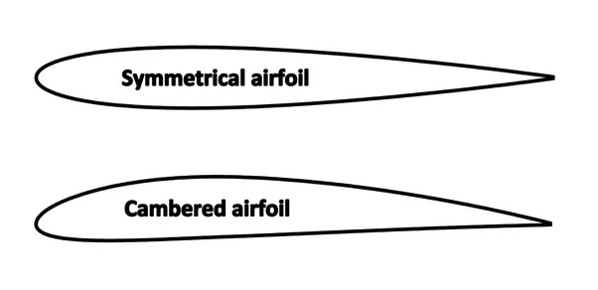
Types of airfoils for flying wings

Slide 5
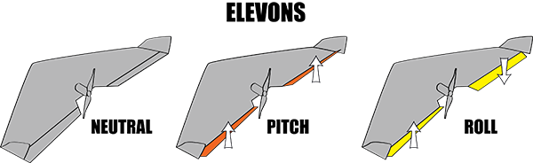
Aerodynamics of the wing

Slide 6
aerodynamics
Flying wings are one of the most promising concepts for the future of commercial aviation,
regarding the market, technology and environmental driving factors. The research
reported here is part of a long term project on the 300 seats category flying wings. In several previously published works the feasibility, efficient performance and airport compatibility
of the concept have been assessed. The present paper concentrates on the flight dynamic aspects of the aircraft, which have been scarcely analysed in open literature. The results
obtained show that the flying wing configuration can be dynamically stable;
however, the longitudinal and lateral directional oscillations decay so slowly that a
stability augmentation system would be required to assure an acceptable dynamic response of the aircraft.

Slide 7
Hardware/electronics
1: Arduino UNO R3
2: Arduino NANO.
3:HC12 or NRF24L01 for Communication.
4: ESC [Electronic Speed Controller].
5: Engine [1400kv motor]Brushless DC motor.
6: 8inches Propeller.
7: Joysticks.
8: Servo Motors.
9: Gyro Sensors (optional).
10: FPV [First Person View] Camera.

Slide 8
Hc12 Transreciever
HC-12 Wireless Transceiver Modules 433Mhz are wireless serial port communication modules, It is based on SI4463 RF chip, it has built in microcontroller, and can be configured using AT commands, Maximum output power is 100mW (20dBm) and receiver sensitivity differs from -117dBm to -100dBm, depending on transmission speed. It accepts 3.2V-5.5V and can be used with 3.3V and 5V UART voltage devices (3.3V safe).
Each HC-12 can work in one of following modes:
FU1 – moderate power saving mode with 250000bps “over the air” baud rate. Serial port baud rate can be set to any supported value
FU2 – extreme power saving mode with 250000bps “over the air” speed. Serial port rate is limited to 1200bps, 2400bps, 4800bps
FU3 – default, general purpose mode. “Over the air” speed differs depending on serial port speed. The same goes for maximum range:
1200bps ~ 1000m
2400bps ~ 1000m
4800bps ~ 500m
9600bps ~ 500m
19200bps ~ 250m
38400bps ~ 250m
57600bps ~ 100m
115200bps ~ 100m

Slide 9
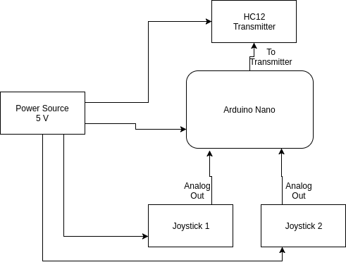
Hc 12 wireless transmitter

Slide 10
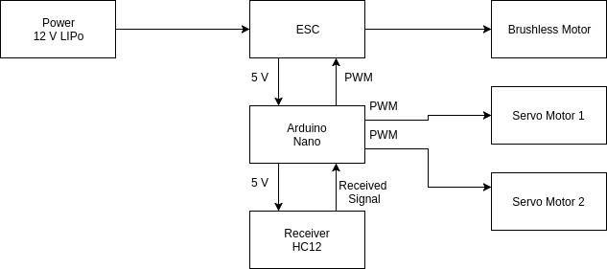
Hc12 wireless reciever

Slide 11
Nrf24l01 transreciever
nRF2401 is a single-chip radio transceiver for the world wide 2.4 - 2.5 GHz ISM
band. The transceiver consists of a fully integrated frequency synthesizer, a power
amplifier, a crystal oscillator and a modulator. Output power and frequency channels
are easily programmable by use of the 3-wire serial interface. Current consumption is
very low, only 10.5mA at an output power of -5dBm and 18mA in receive mode.
Built-in Power Down modes makes power saving easily realizable.

Slide 12
1) Usable band is determined by local regulations
2) The crystal frequency may be chosen from 5 different values (4, 8, 12, 16, and 20MHz) which are specified in
the configuration word, see Table 8. 16MHz are required for 1Mbps operation.
3) Data rate must be either 250kbps or 1000kbps.
4) De-embedded Antenna load impedance = 400 W
5) De-embedded Antenna load impedance = 400 W. Effective data rate 250kbps or 1Mbps.
6) De-embedded Antenna load impedance = 400 W. Effective data rate 10kbps.
7) Current if 4 MHz crystal is used.

Slide 13
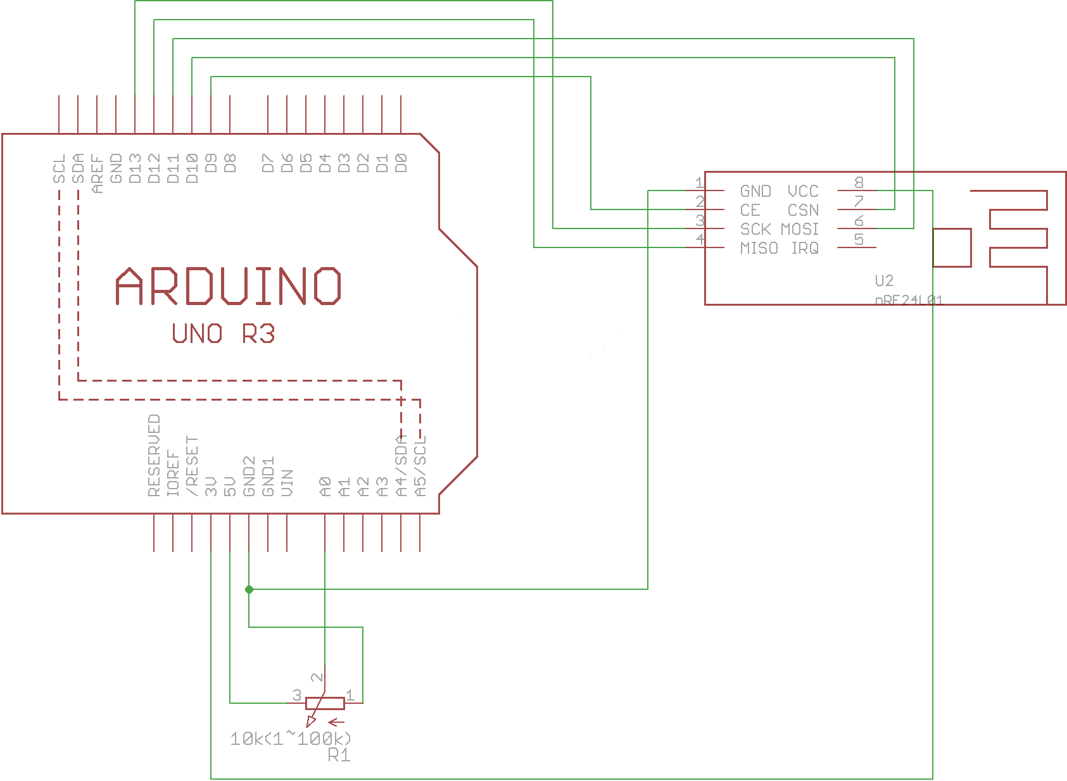
Nrf24L01 interfacing with arduino

Slide 14
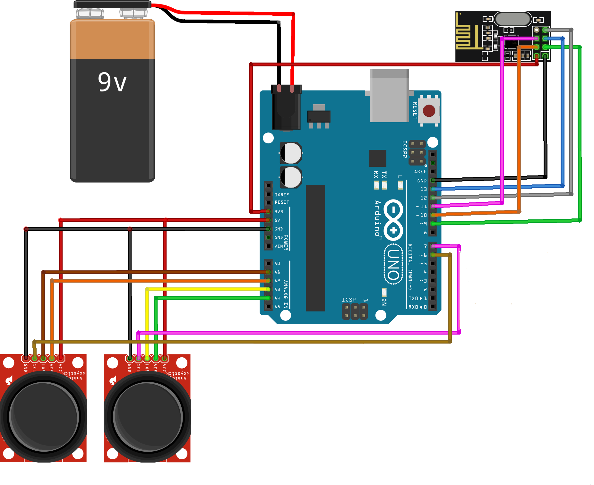
Nrf24l01 transmitter

Slide 15
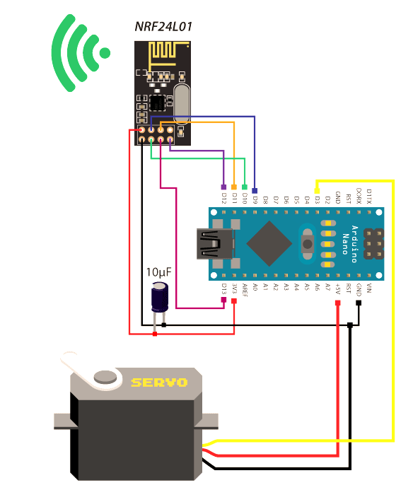
Nrf24l01 reciever

Slide 16
Arduino Uno r3
The Arduino Uno is a microcontroller board based on the ATmega328. Arduino is an open-source, prototyping platform and its simplicity makes it ideal for hobbyists to use as well as professionals. The Arduino Uno has 14 digital input/output pins (of which 6 can be used as PWM outputs), 6 analog inputs, a 16 MHz crystal oscillator, a USB connection, a power jack, an ICSP header, and a reset button. It contains everything needed to support the microcontroller; simply connect it to a computer with a USB cable or power it with an AC-to-DC adapter or battery to get started.
The Arduino Uno differs from all preceding boards in that it does not use the FTDI USB-to-serial driver chip. Instead, it features the Atmega8U2 microcontroller chip programmed as a USB-to-serial converter.
Features of the Arduino UNO:
Microcontroller: ATmega328
Operating Voltage: 5V
Input Voltage (recommended): 7-12V
Input Voltage (limits): 6-20V
Digital I/O Pins: 14 (of which 6 provide PWM output)
Analog Input Pins: 6
DC Current per I/O Pin: 40 mA
DC Current for 3.3V Pin: 50 mA
Flash Memory: 32 KB of which 0.5 KB used by bootloader
SRAM: 2 KB (ATmega328)
EEPROM: 1 KB (ATmega328)
Clock Speed: 16 MHz

Slide 17
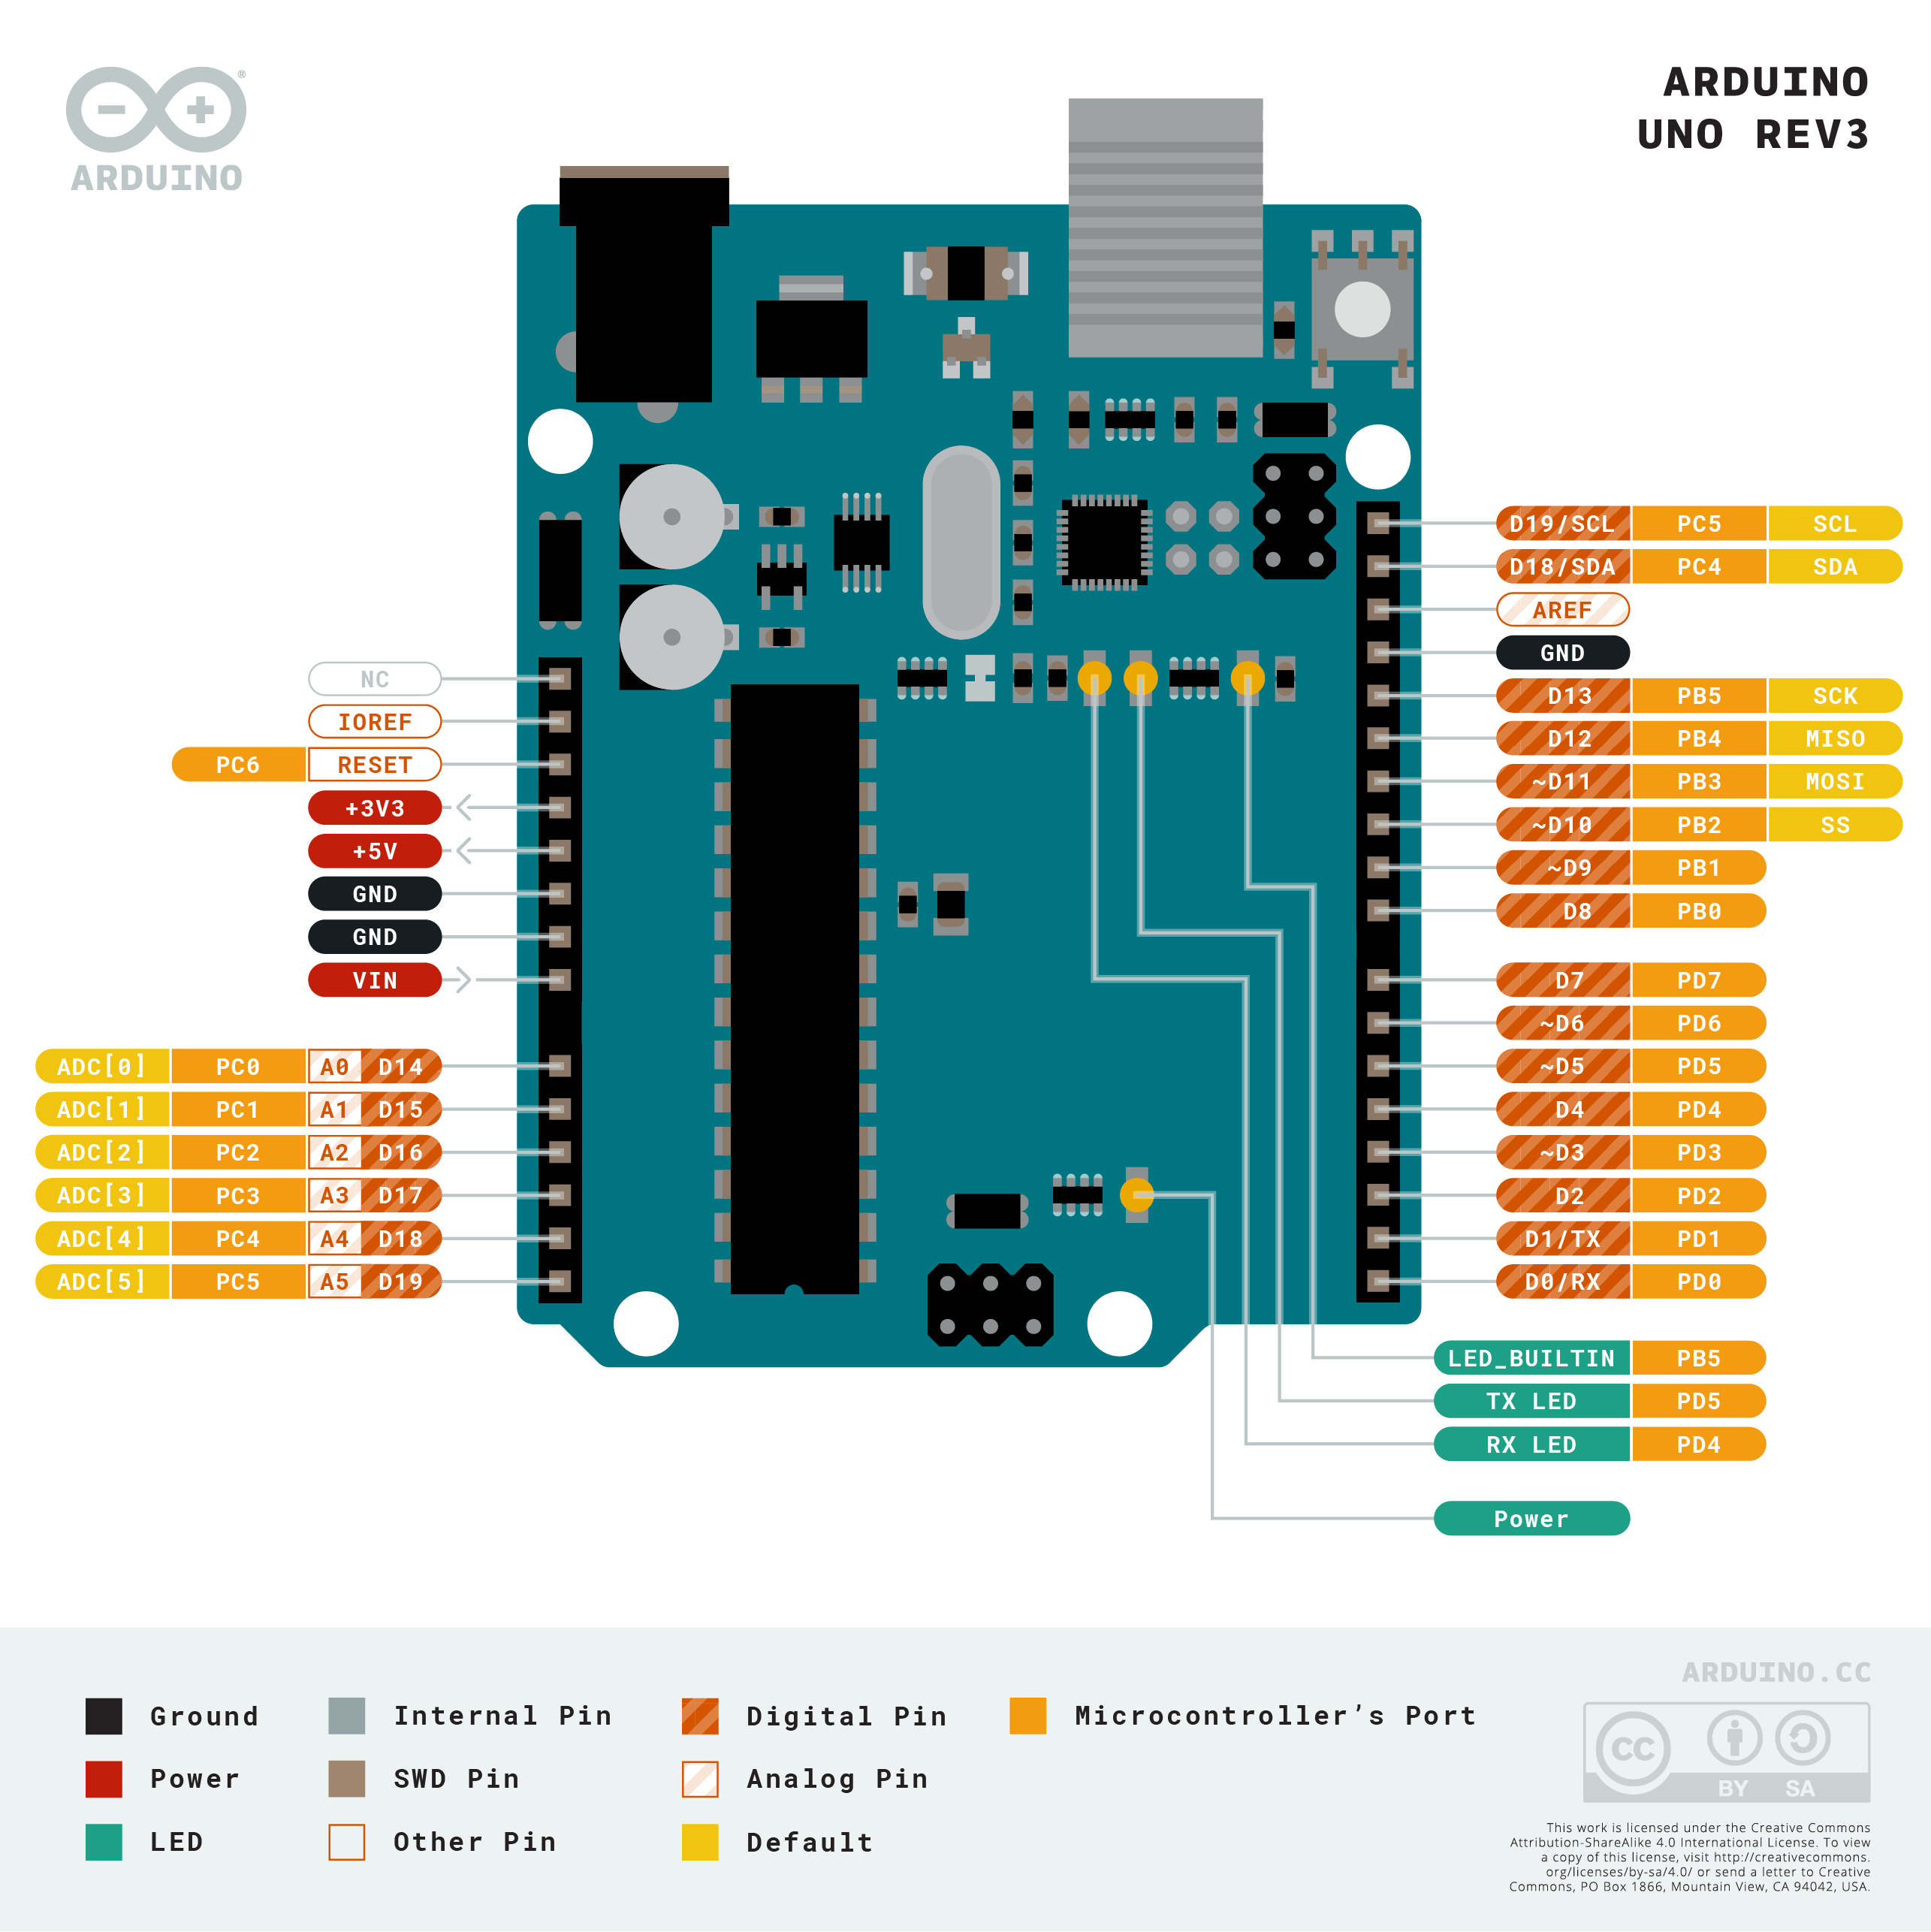
Arduino uno r3

Slide 18
Gyro sensors(optional)
The MPU-6050 is a serious little piece of motion processing tech! By combining a MEMS 3-axis gyroscope and a 3-axis accelerometer on the same silicon die together with an onboard Digital Motion Processor™ (DMP™) capable of processing complex 9-axis MotionFusion algorithms, the MPU-6050 does away with the cross-axis alignment problems that can creep up on discrete parts.
Features
I2C Digital-output of 6 or 9-axis MotionFusion data in rotation matrix, quaternion, Euler Angle, or raw data format
Input Voltage: 2.3 - 3.4V
Selectable Solder Jumpers on CLK, FSYNC and AD0
Tri-Axis angular rate sensor (gyro) with a sensitivity up to 131 LSBs/dps and a full-scale range of ±250, ±500, ±1000, and ±2000dps
Tri-Axis accelerometer with a programmable full scale range of ±2g, ±4g, ±8g and ±16g
Digital Motion Processing™ (DMP™) engine offloads complex MotionFusion, sensor timing synchronization and gesture detection
Embedded algorithms for run-time bias and compass calibration. No user intervention required
Digital-output temperature sensor
Specifications
Chip: MPU-6050
Power supply: 3~5V Onboard regulator
Communication mode: standard IIC communication protocol
Chip built-in 16bit AD converter, 16bit data output
Gyroscopes range: +/- 250 500 1000 2000 degree/sec
Acceleration range: +/- 2g, +/- 4g, +/- 8g, +/- 16g
Pin pitch: 2.54mm

Slide 19
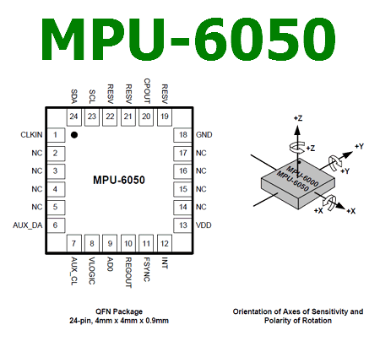
Mpu6050 gyro sensor

Slide 20
esc[electronic speed controller]
This is fully programmable 30A BLDC ESC with 5V, 2A BEC. Can drive motors with continuous 30Amp load current. It has sturdy construction with heatsink on the MOSFETs for better heat dissipation. It can be powered with 2-4 lithium Polymer batteries or 5-12 NiMH / NiCd batteries. It has separate voltage regulator for the microcontroller for providing good anti-jamming capability. It is most suitable for UAVs, Aircrafts and Helicopters.
Note: This BLDC ESC is factory programmed and ready to use. You should program it only to customize it as per your requirements.
Specifications
Output: 30A continuous; 35Amps for 10 seconds
Input voltage: 2-4 cells Lithium Polymer / Lithium Ion battery or 5-12 cells NiMH / NiCd
BEC: 5V, 2Amp for external receiver and servos
Max Speed: 2 Pole: 210,000rpm; 6 Pole: 70,000rpm; 12 Pole: 35,000rpm
Weight: 22gms
Size: 47mm x 27mm x 12mm

Slide 21
engine
BRUSHLESS MOTOR 1400 KV BLDC motor is best used for airplane, aircraft or quad copter. This brushless motor comes with 80% maximum efficiency, 4-10A max current efficiency and 12A / 60s current capacity.?
Specifications:
RPM/V: 1400
Stator Diameter (mm) :22
Stator length (mm) : 13
Stator Arms (mm) : 12
RPM (KV) : 1400
Idle Current (A): 0.68/8
Max Current (A): 20
Max Power (W): 220/3
Rotor Dia (mm): 28
Shaft Dia (mm): 3.17
Motor Length (mm): 28
Overall Length (mm): 42
Biggest Thrust g/S: 1265/4

Slide 22
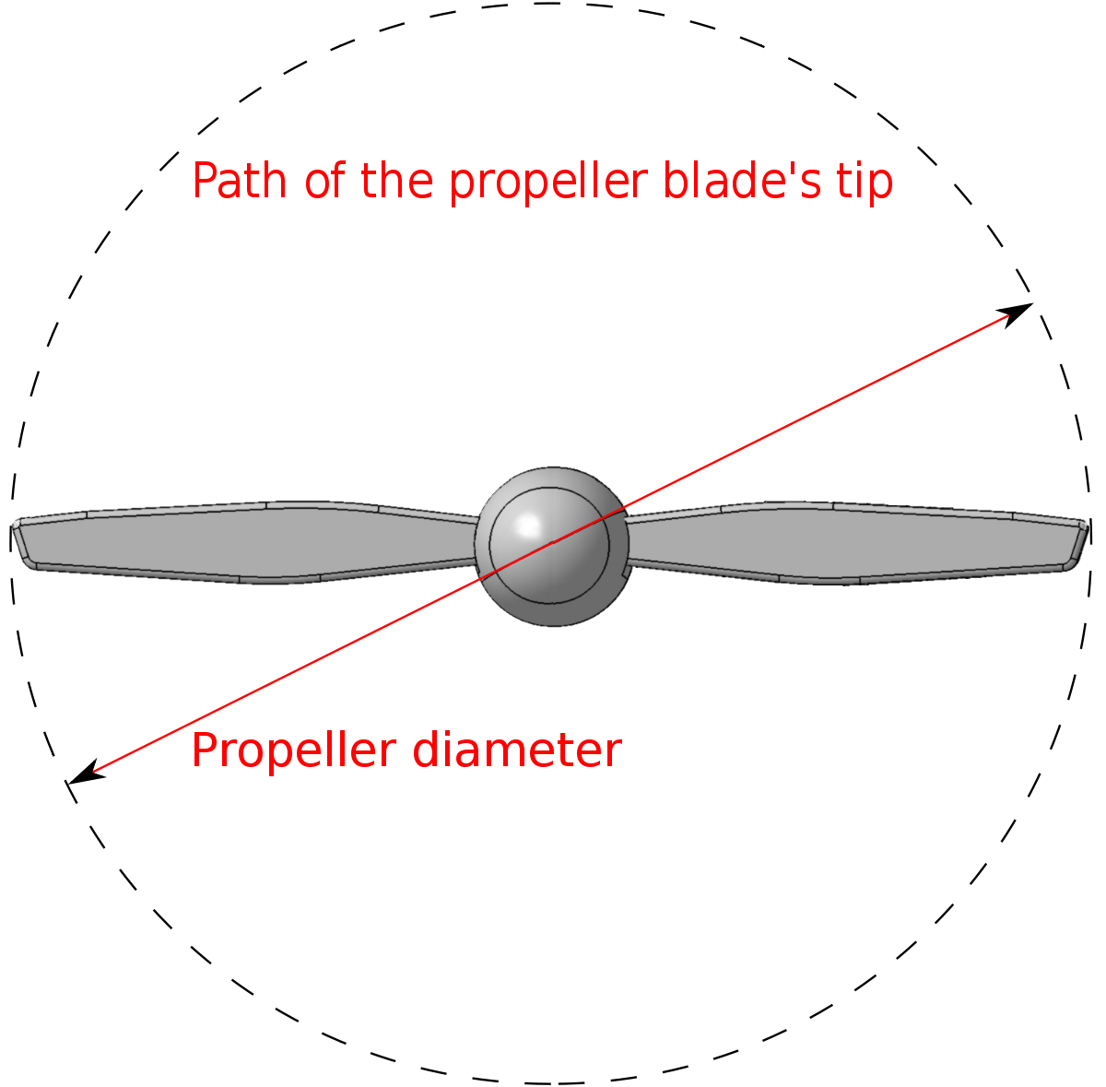
propeller
8045(80×4.5) SF Props have high-quality propellers specially designed for multi-copters. 8045(80×4.5) SF Props has a 15° angle design at the end of the propeller to avoid whirlpool multi-copter flying.

Slide 23
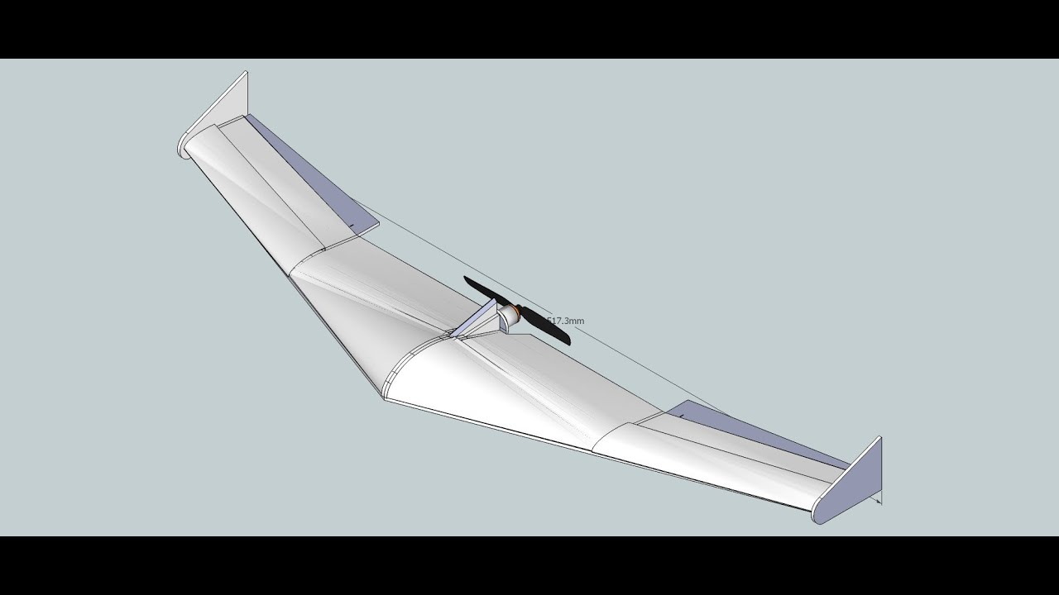
Wing design

Slide 24
Wing details
A flying wing is a tailless fixed-wing aircraft that has no definite fuselage. The crew, payload, fuel, and equipment are typically housed inside the main wing structure, although a flying wing may have various small protuberances such as pods, nacelles, blisters, booms, or vertical stabilizers.^{[1]}
Similar aircraft designs that are not, strictly speaking, flying wings, are sometimes referred to as such. These types include blended wing body aircraft, and microlights (such as the Aériane Swift), which typically carry the pilot (and engine when fitted) below the wing.

Slide 25
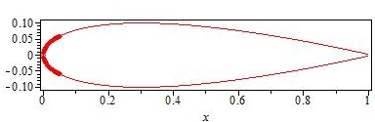
The leading edge
The leading edge is the part of the wing that first contacts the air;^{[1]} alternatively it is the foremost edge of an airfoil section.^{[2]} The first is an aerodynamic definition, the second a structural one. As an example of the distinction, during a tailslide, from an aerodynamic point of view, the trailing edge becomes the leading edge and vice versa but from a structural point of view the leading edge remains unchanged.
A leading-edge cuff is a fixed aerodynamic wing device employed on fixed-wing aircraft to improve the stall and spin characteristics. Cuffs may be either factory-designed or an after-market add-on modification.^{[1]}
A leading-edge cuff is a wing leading-edge modification, usually a lightly drooped outboard leading-edge extension. In most cases of outboard leading-edge modification, the wing cuff starts about 50–70% half-span and spans the outer leading edge of the wing.^{[2]}
The main goal is to produce a more gradual and gentler stall onset, without any spin departure tendency, particularly where the original wing has a sharp/asymmetric stall behaviour ^{[1][3]} with a passive, non-moving, low-cost device that would have a minimal impact on performance. A further benefit is to lowering stall speed, with lower approach speeds and shorter landing distances. They may also, depending on cuff location, improve aileron control at low speed.

Slide 26
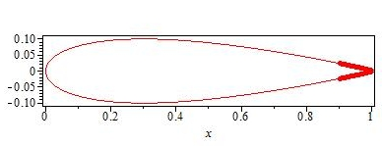
The trailing edge
The trailing edge of an aerodynamic surface such as a wing is its rear edge, where the airflow separated by the leading edge rejoins.^{[1]} Essential flight control surfaces are attached here to control the direction of the departing air flow, and exert a controlling force on the aircraft. Such control surfaces include ailerons on the wings for roll control, elevators on the tailplane controlling pitch, and the rudder on the fin controlling yaw. Elevators and ailerons may be combined as elevons on tailless aircraft.
The shape of the trailing edge is of prime importance in the aerodynamic function of any aerodynamic surface. George Batchelor has written about:
“ ... the remarkable controlling influence exerted by the sharp trailing edge of an aerofoil on the circulation.”^{[2]}
Other sharp-edged surfaces that are attached to the trailing edges of wings or control surfaces include:
On control surfaces:
trim tabs
servo tabs
anti-servo tabs

Slide 27
Government implementations
Mapping of Landslide Affected Area.
Infested Crop Damage Assessment.
3-Dimensioinal Terrain Model Construction.
Aerial Surveillance.
Aerial Wildlife Photography.
Land Mapping.

Slide 28
Thank you

